Slide 1

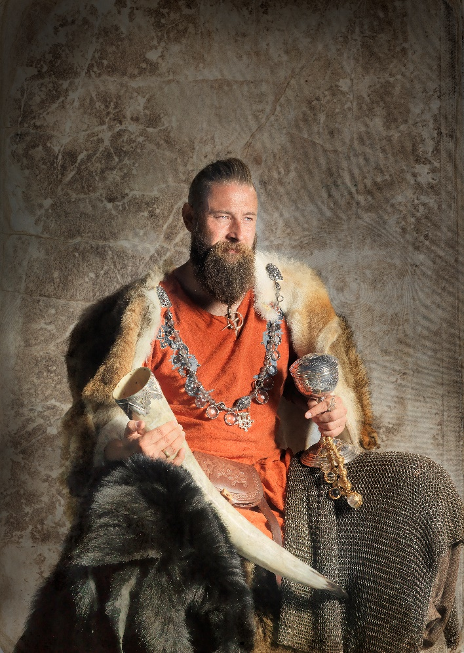
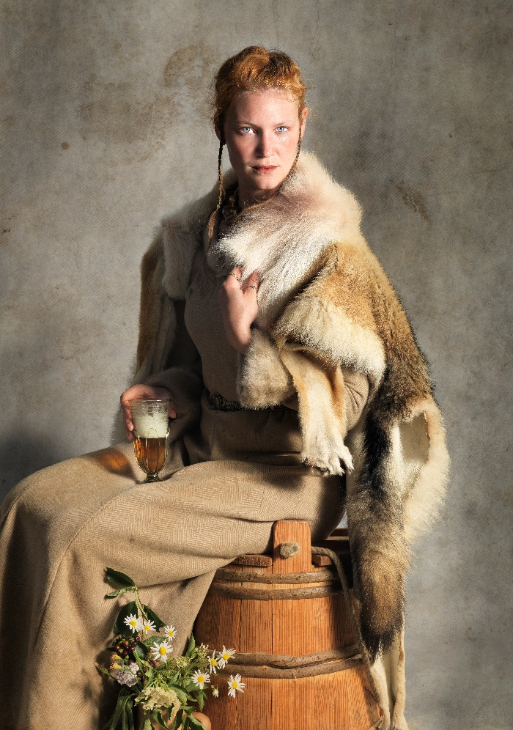
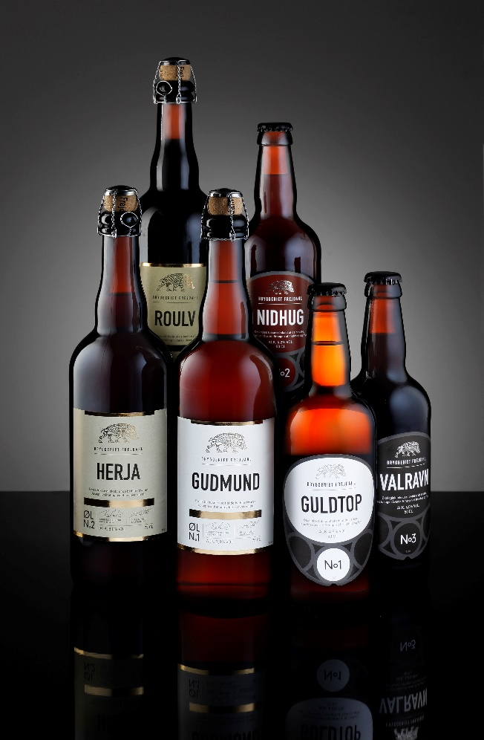
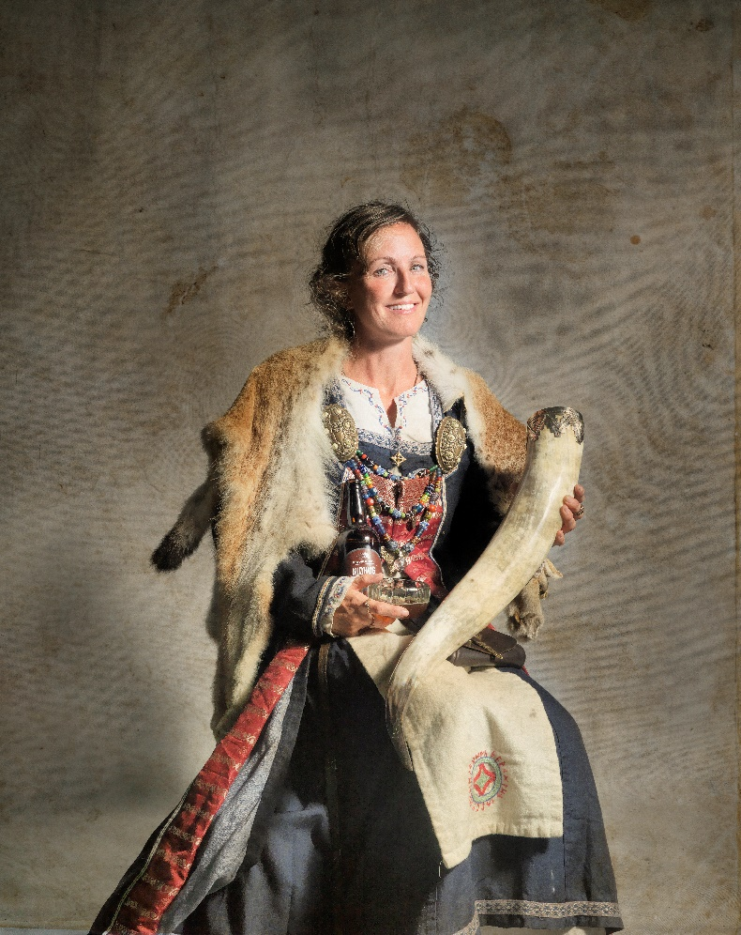

Notes:
Exiting titel

Slide 2

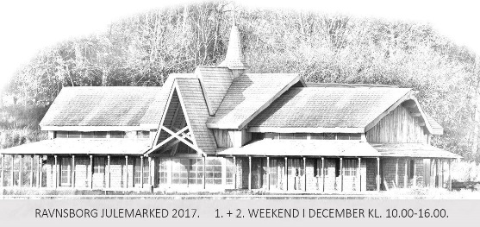


Dorthe Kildal Johannsen Owner of ShoppingBAZAR – fair nr. 100 Marketing, events and fairs at Bryggeriet Vestfyen Viking events at Jim Lyngvild´s viking castle Fundraiser for childrens projects Events for ministers, celebrities etc.

Slide 3
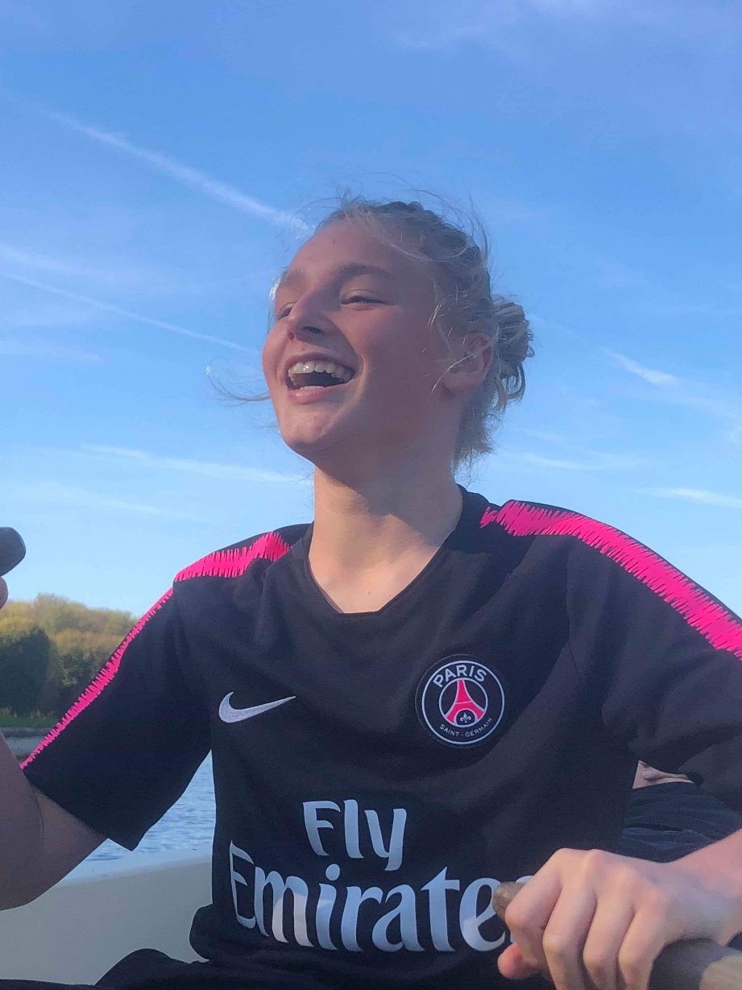
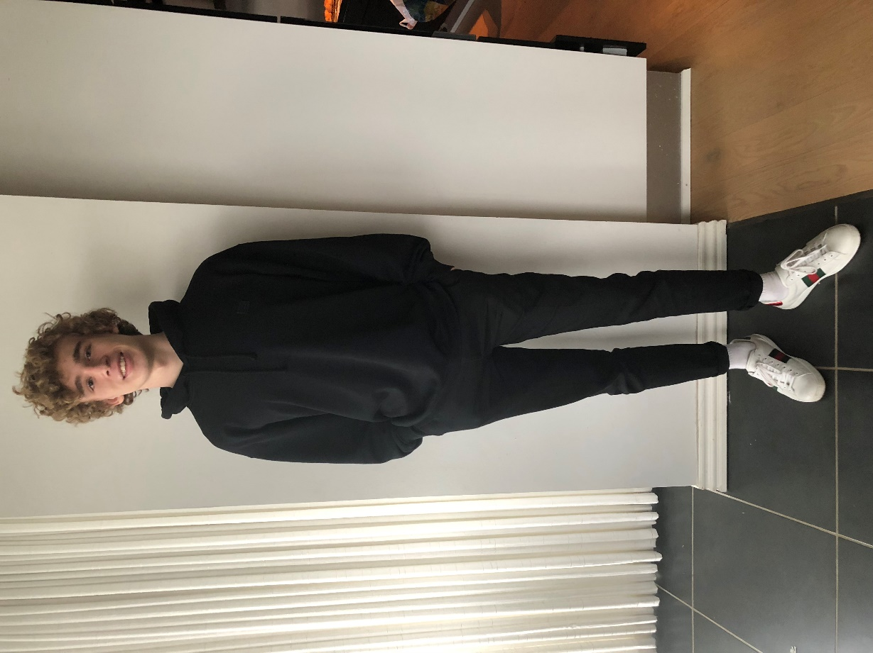
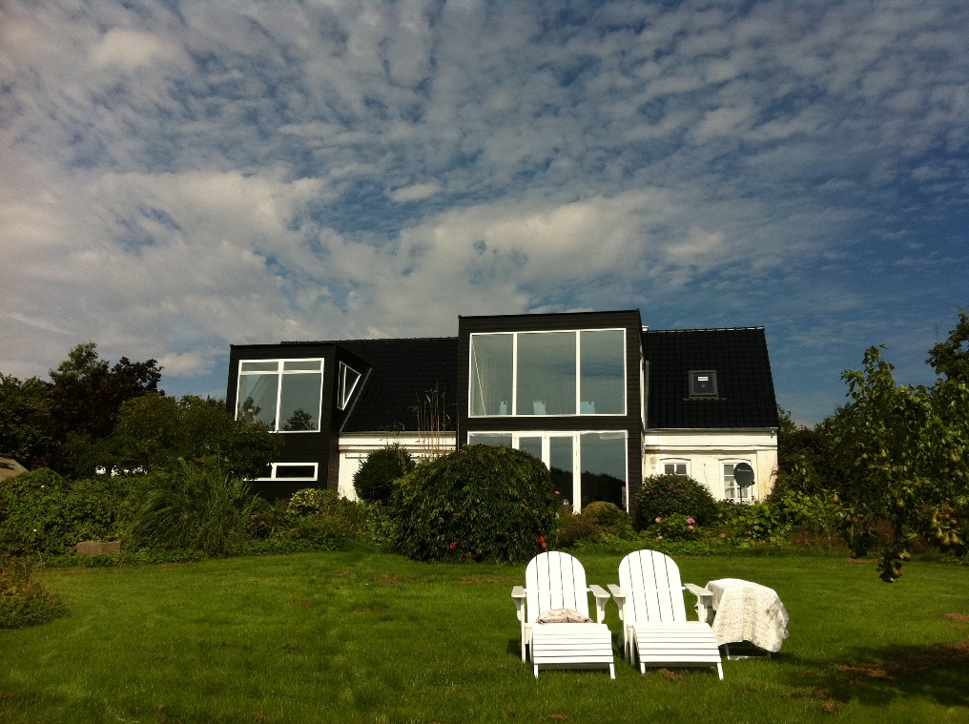
Phillip and Frederik

Slide 4
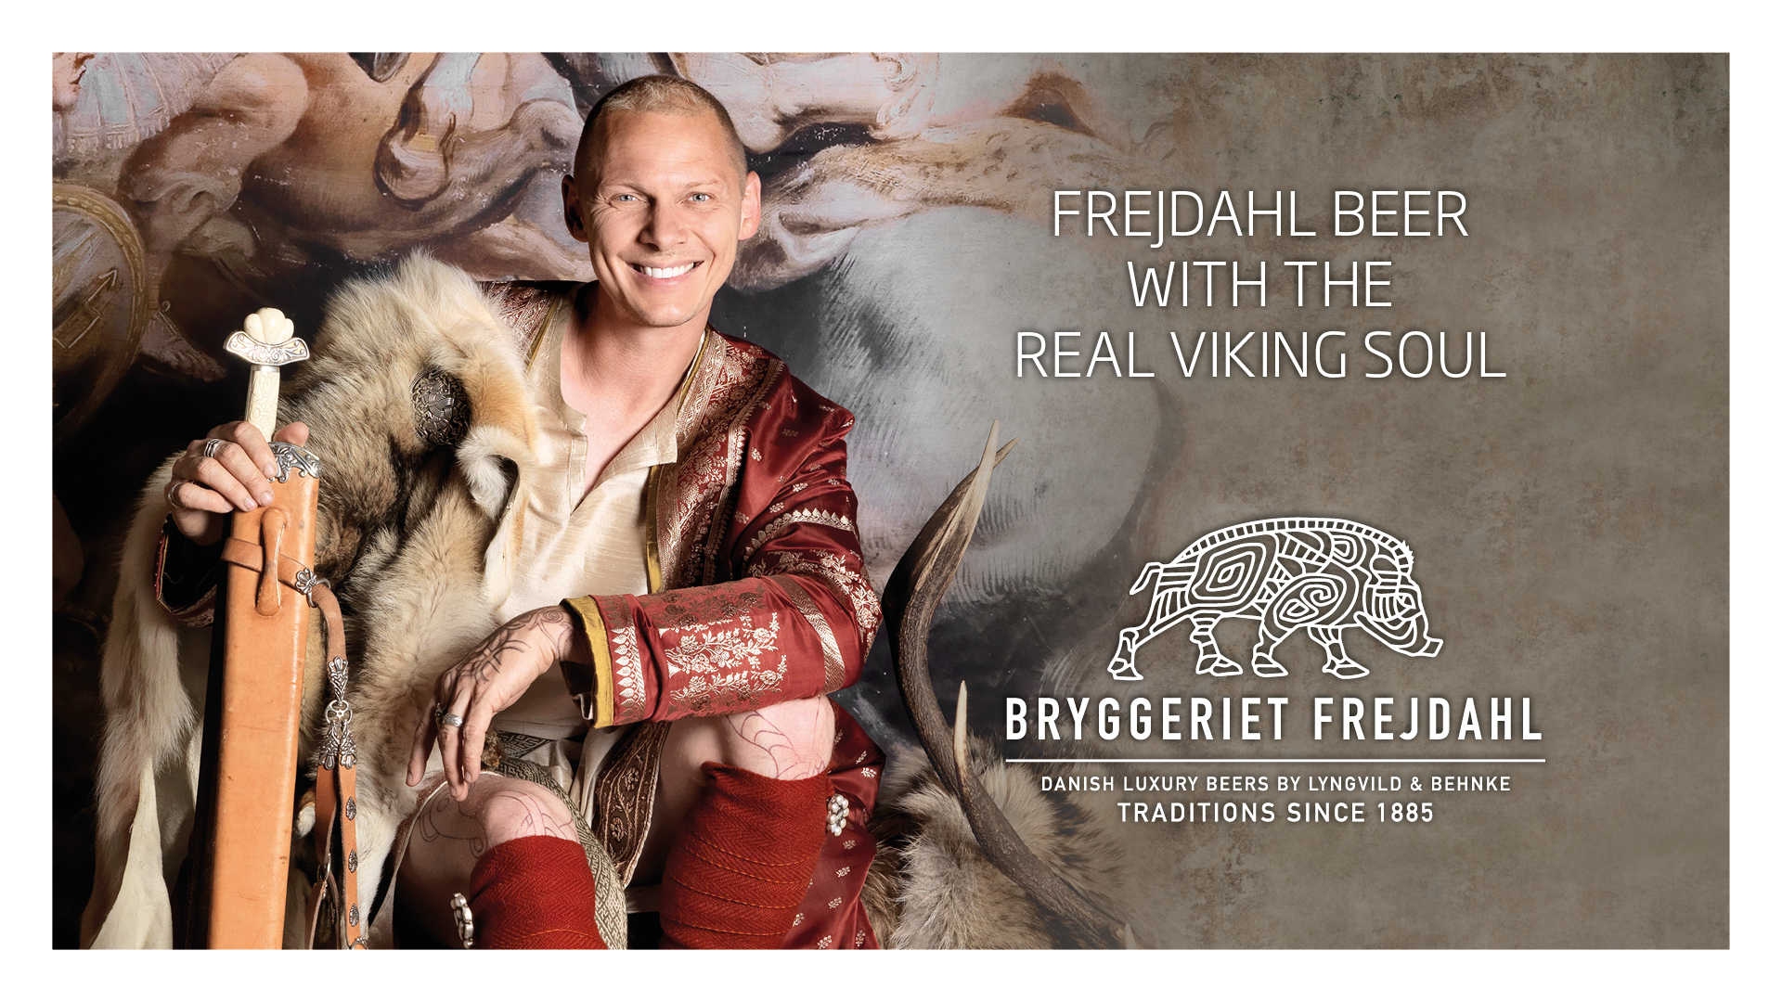

Slide 5
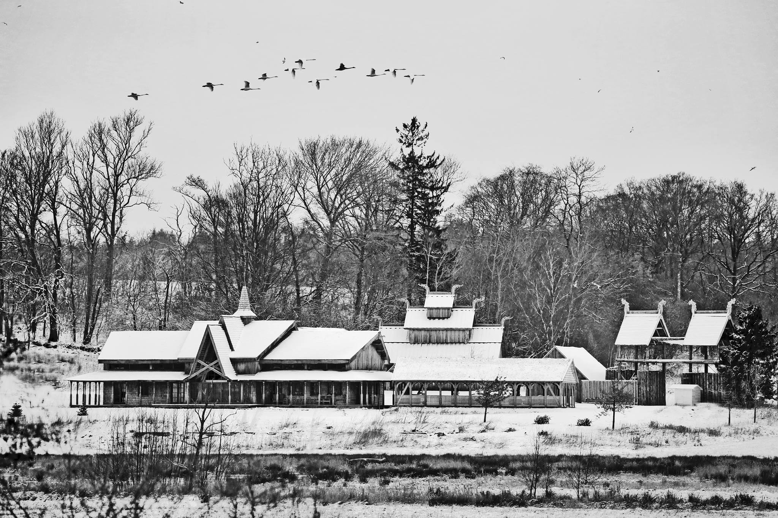

Slide 6
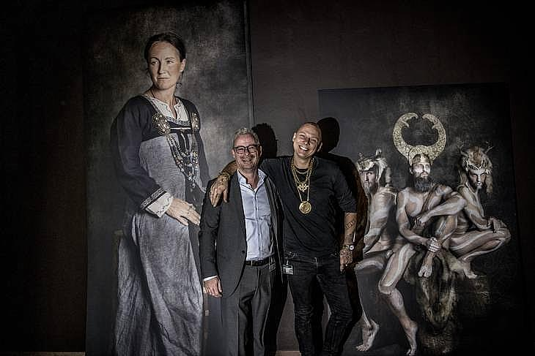
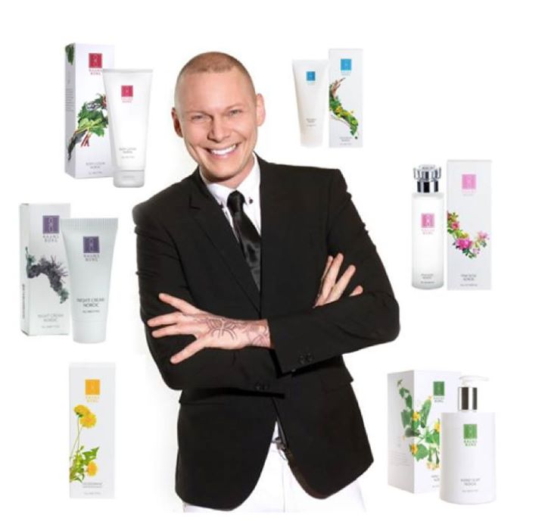
The man behind - Jim Lyngvild
Knows all about vikings and lives in a viking castle Bryggeriet Frejdahl Raunsborg Nordic Nationalmuseum viking exhibition Excellent photograf Make fashionshows in China for Kopenhagen Fur One of my best friends

Slide 7
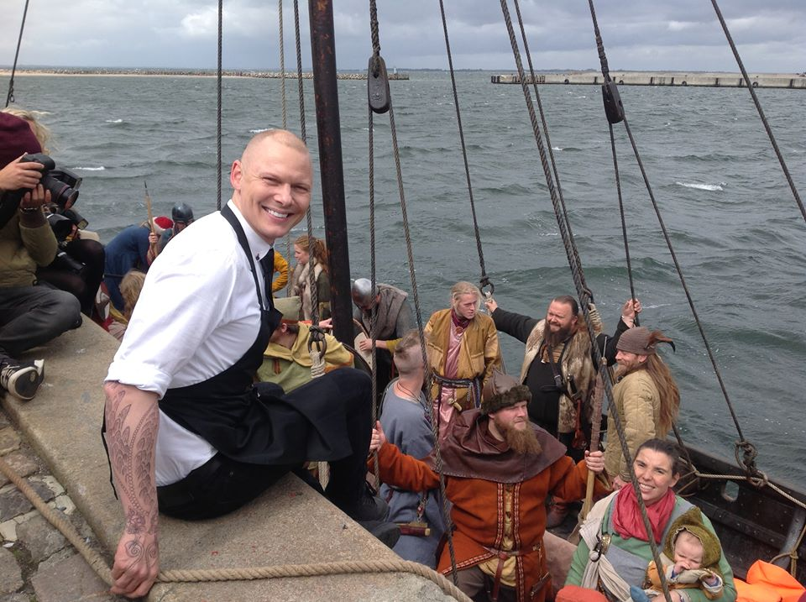
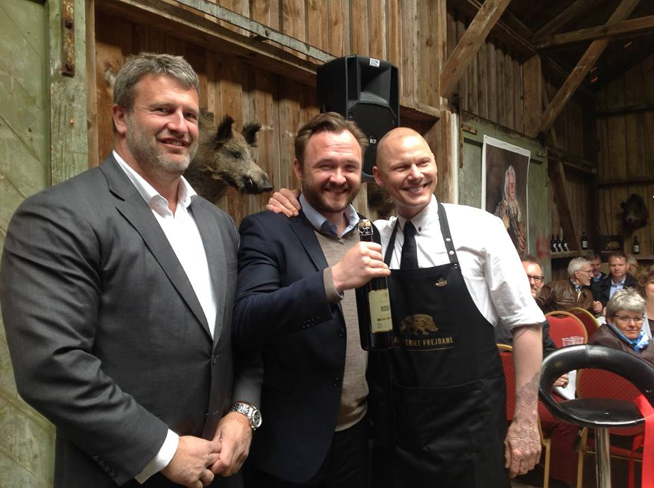

Slide 8
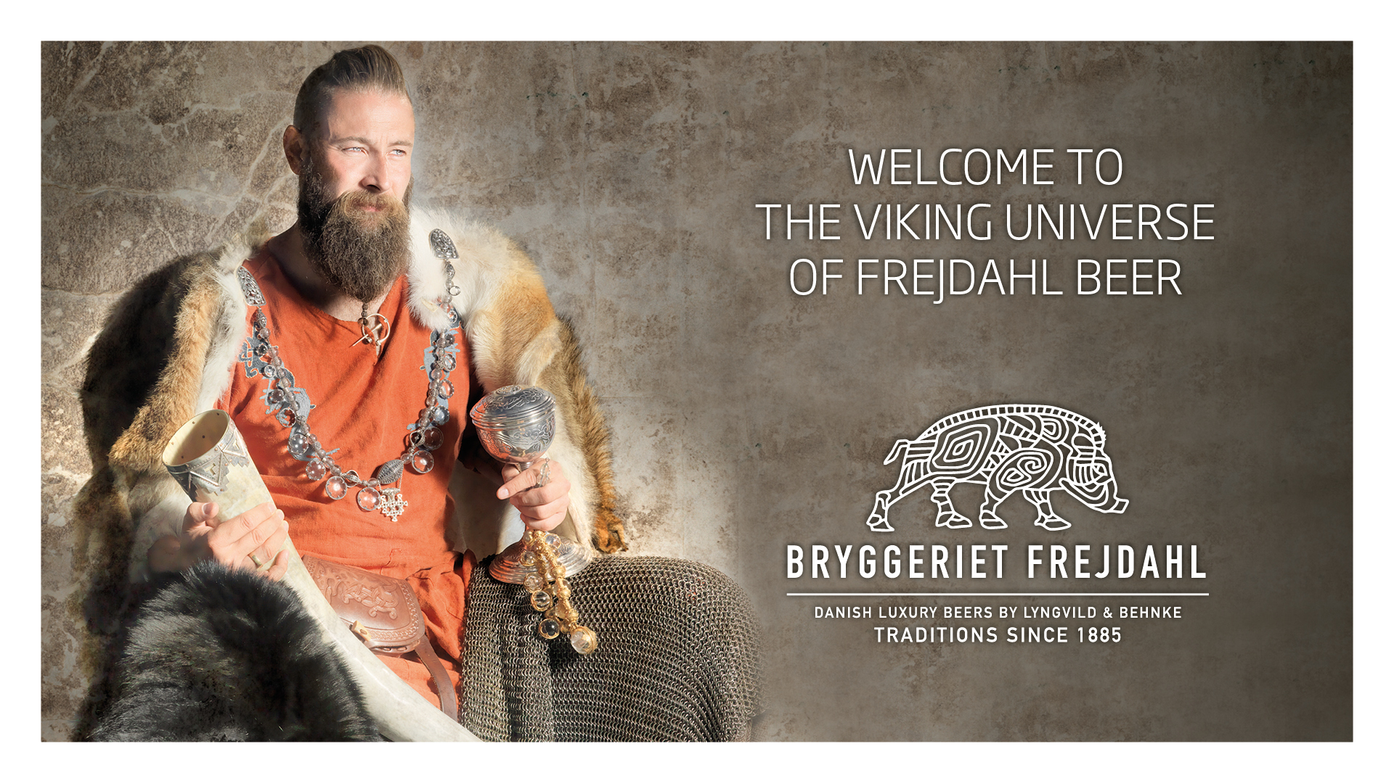

Slide 9
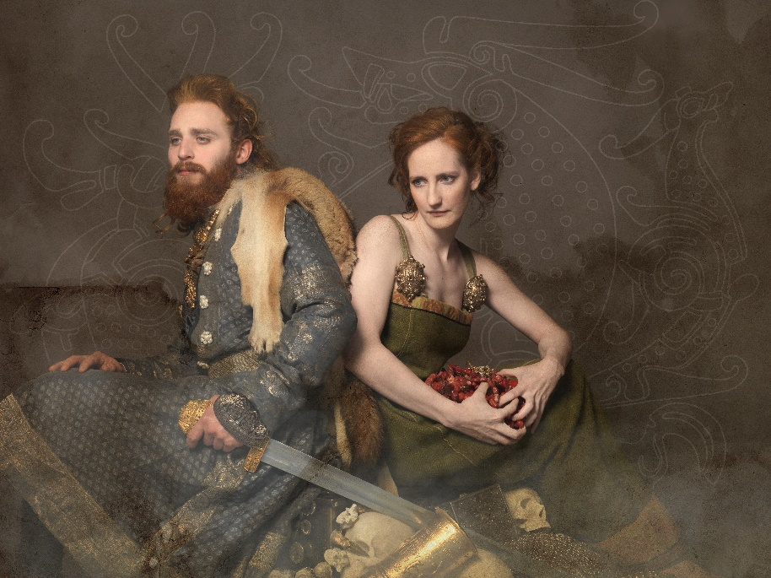
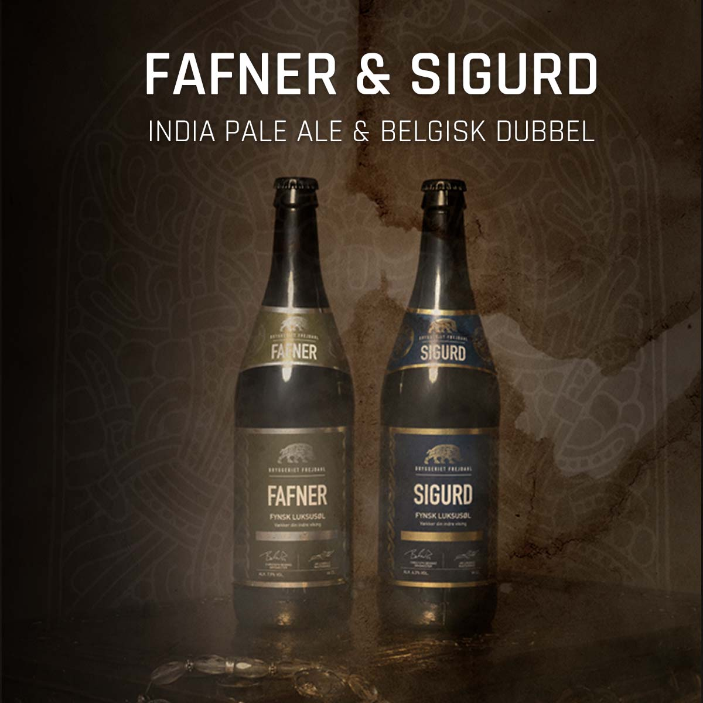
FREJDAHL VIKING BEERS
Luxury beers rooted in our Nordic heritage Unites taste, design and Nordic history Design and storytelling Jim Lyngvild Proud brewing traditions since 1885 Awardwinning brew master Ingrediens with inspiration from the viking age Beernames from the Nordic mythology such as Sigurd, Fafner, Valravn, Nidhug and Gudmund.

Slide 10
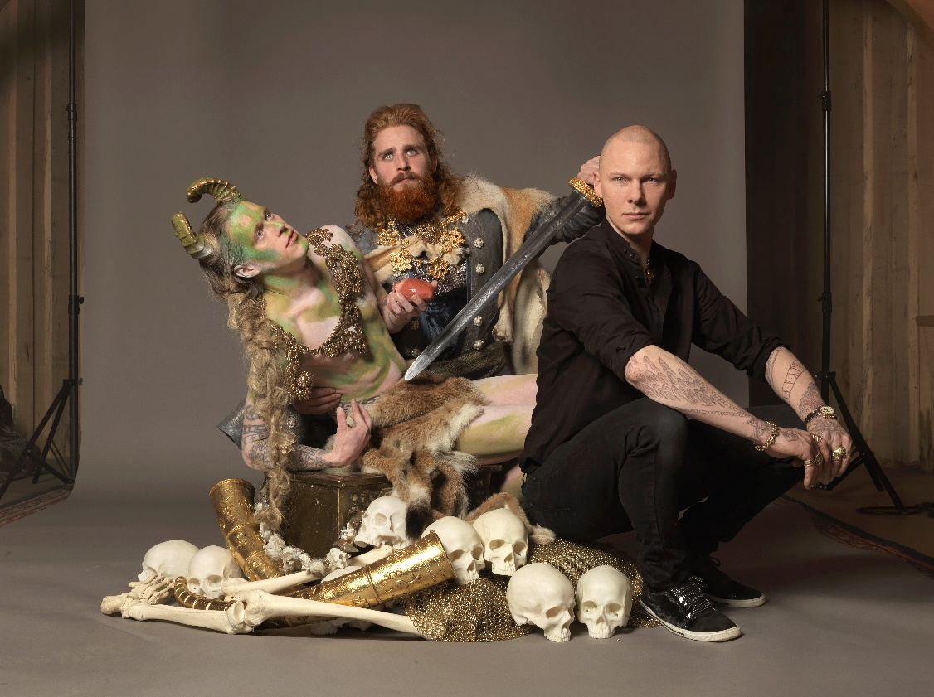
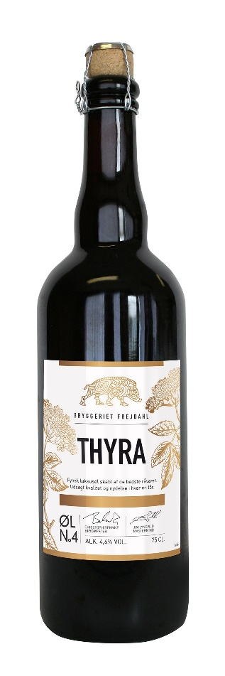
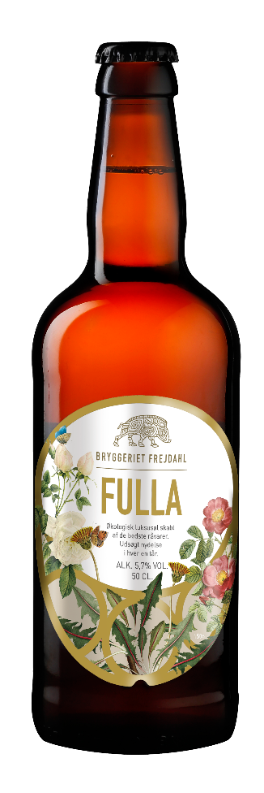
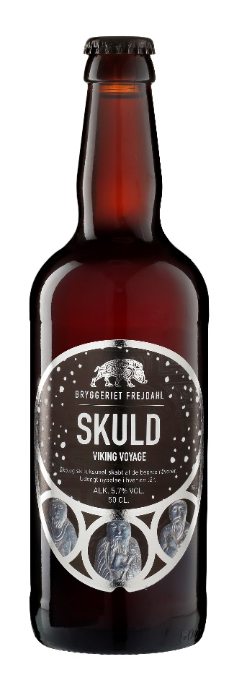
FREJDAHL FOTOSHOOT AND STORYTELLING
Storytelling is everything in our brand We all love our Nordic history Visually branding on the beers Fotoshoot with the dragon Fafner and the viking Sigurd

Slide 11
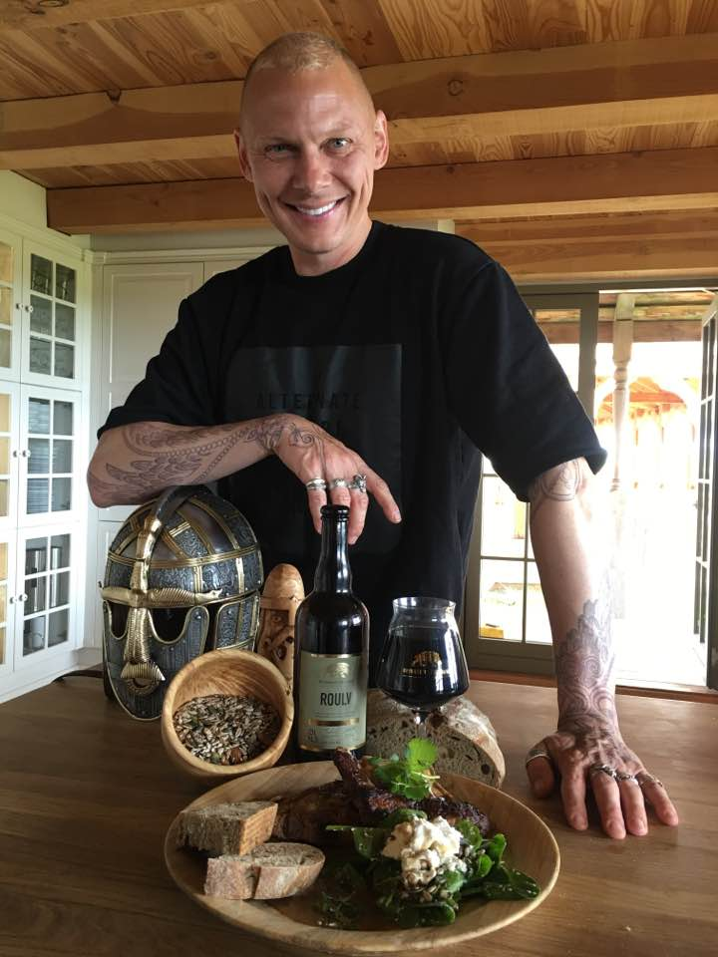
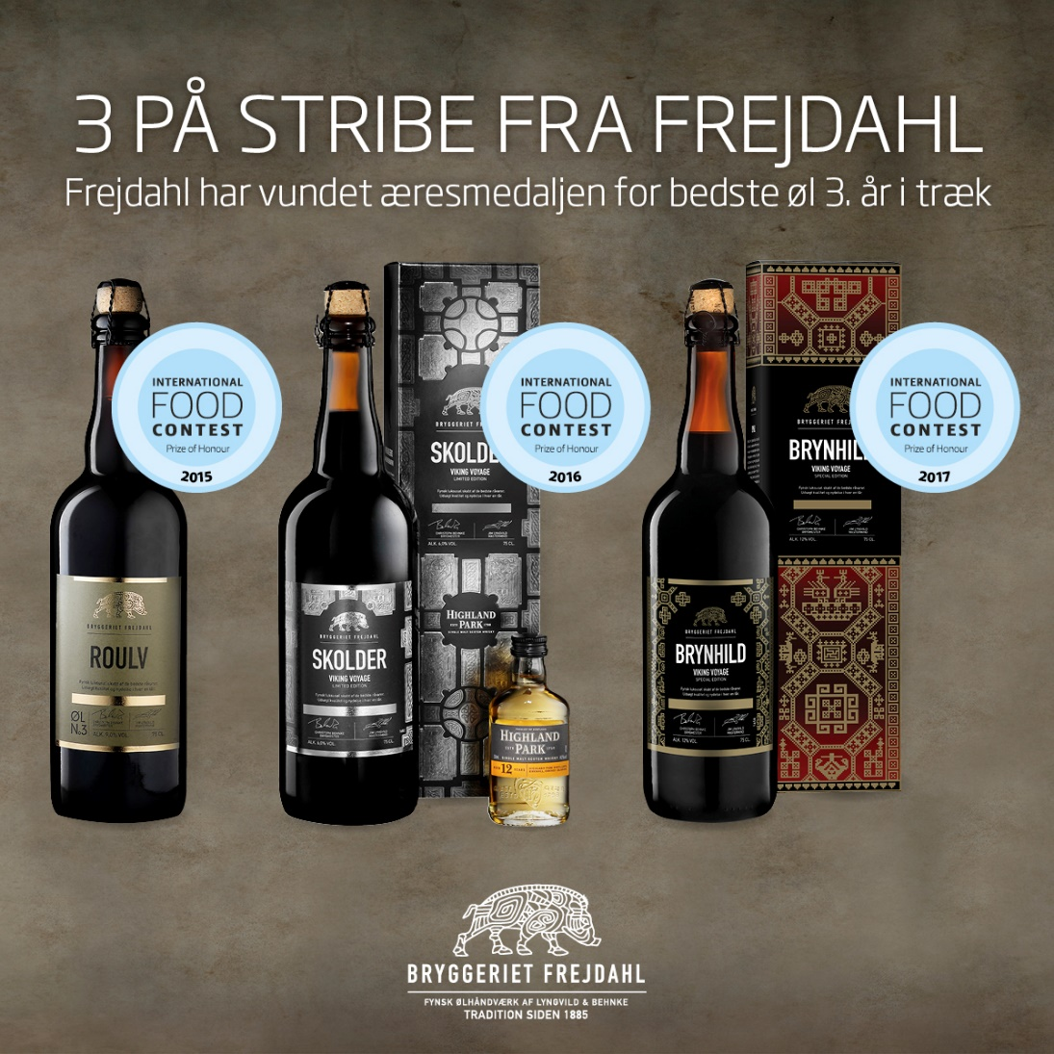
MORE THAN BEERS
Beer with Highland Park Whisky Dessert beer with the taste of peach Beer with Elderflower, plums, mead etc. International prices in Brussel, Germany and Denmark Wine glas for luxury beers Beers for cooking – strong alcohol %

Slide 12
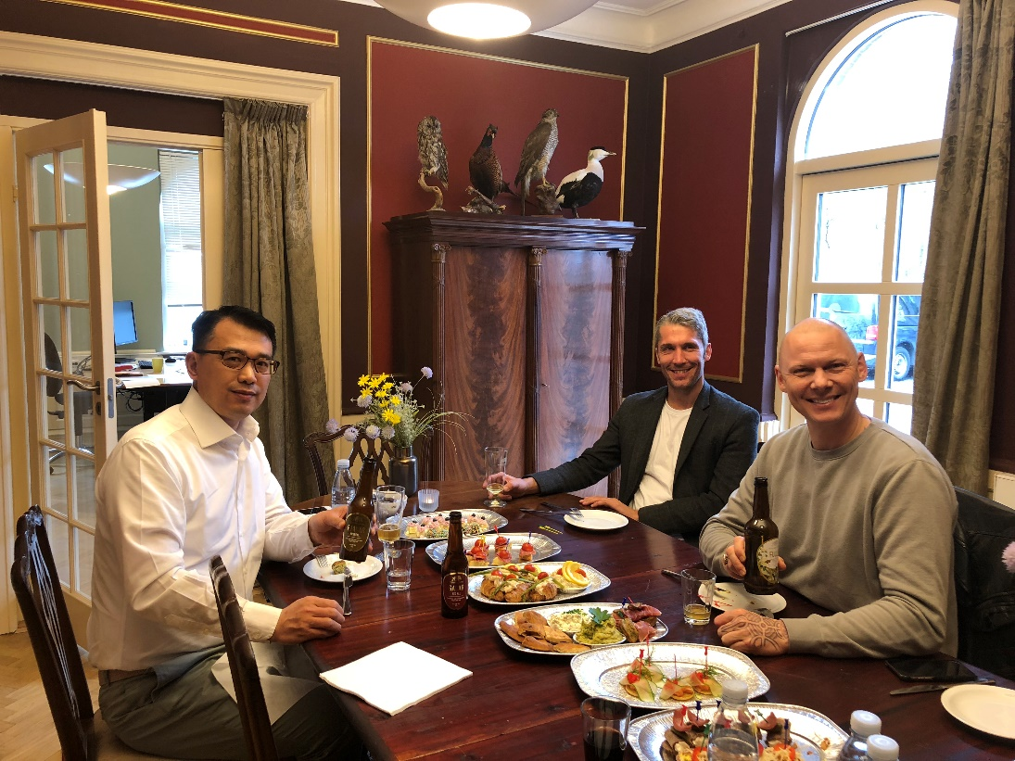
VIKING BRAND IS SELLING ALL OVER THE WORLD
Great taste Exclusive design Storytelling The beer taste better, if you know the story Awardwinning brewer In China Frejdahl is ”the beer” Keep the red line in your concept

Slide 13
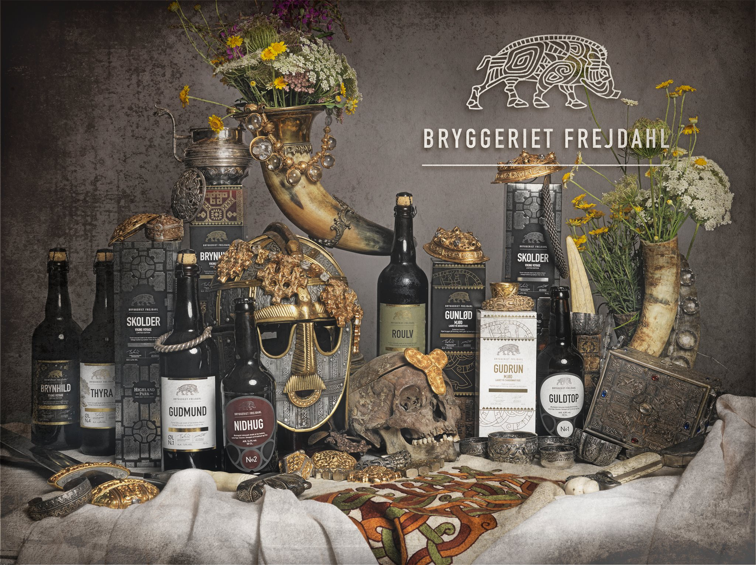
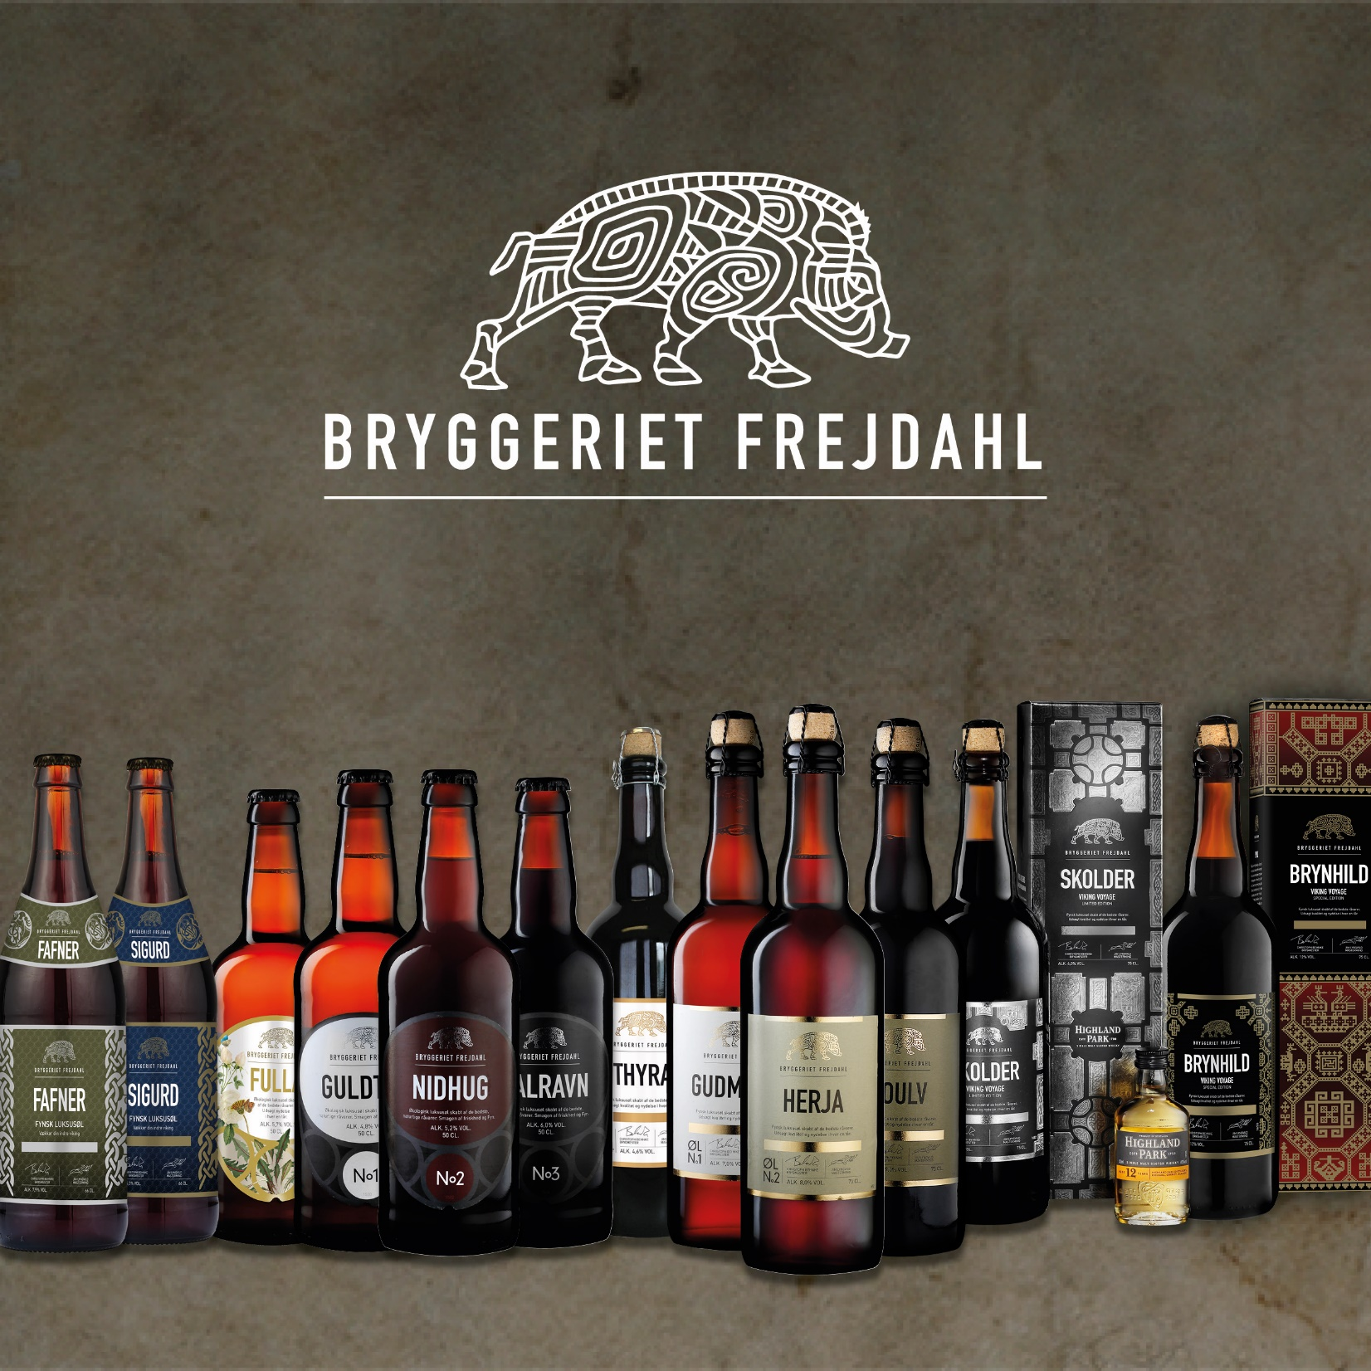

Slide 14
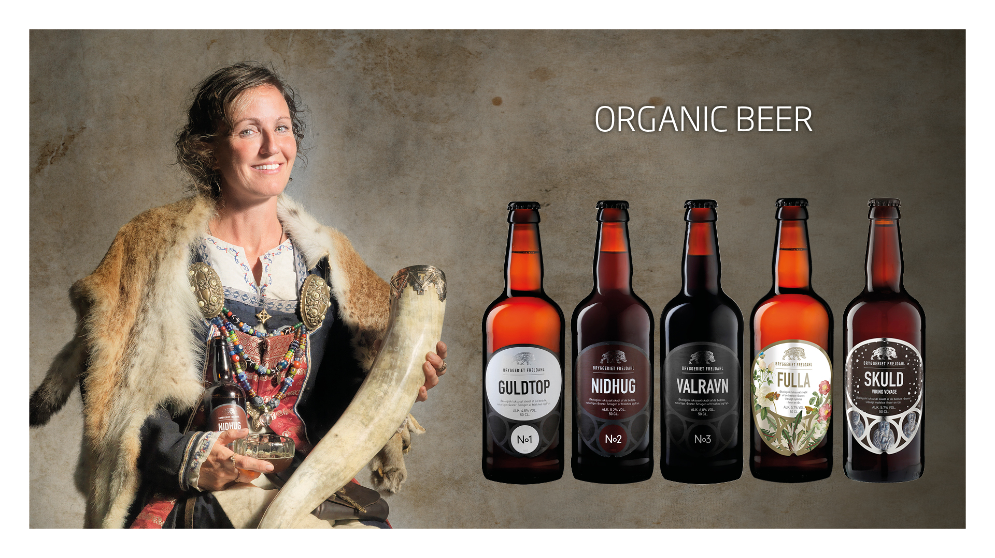

Slide 15
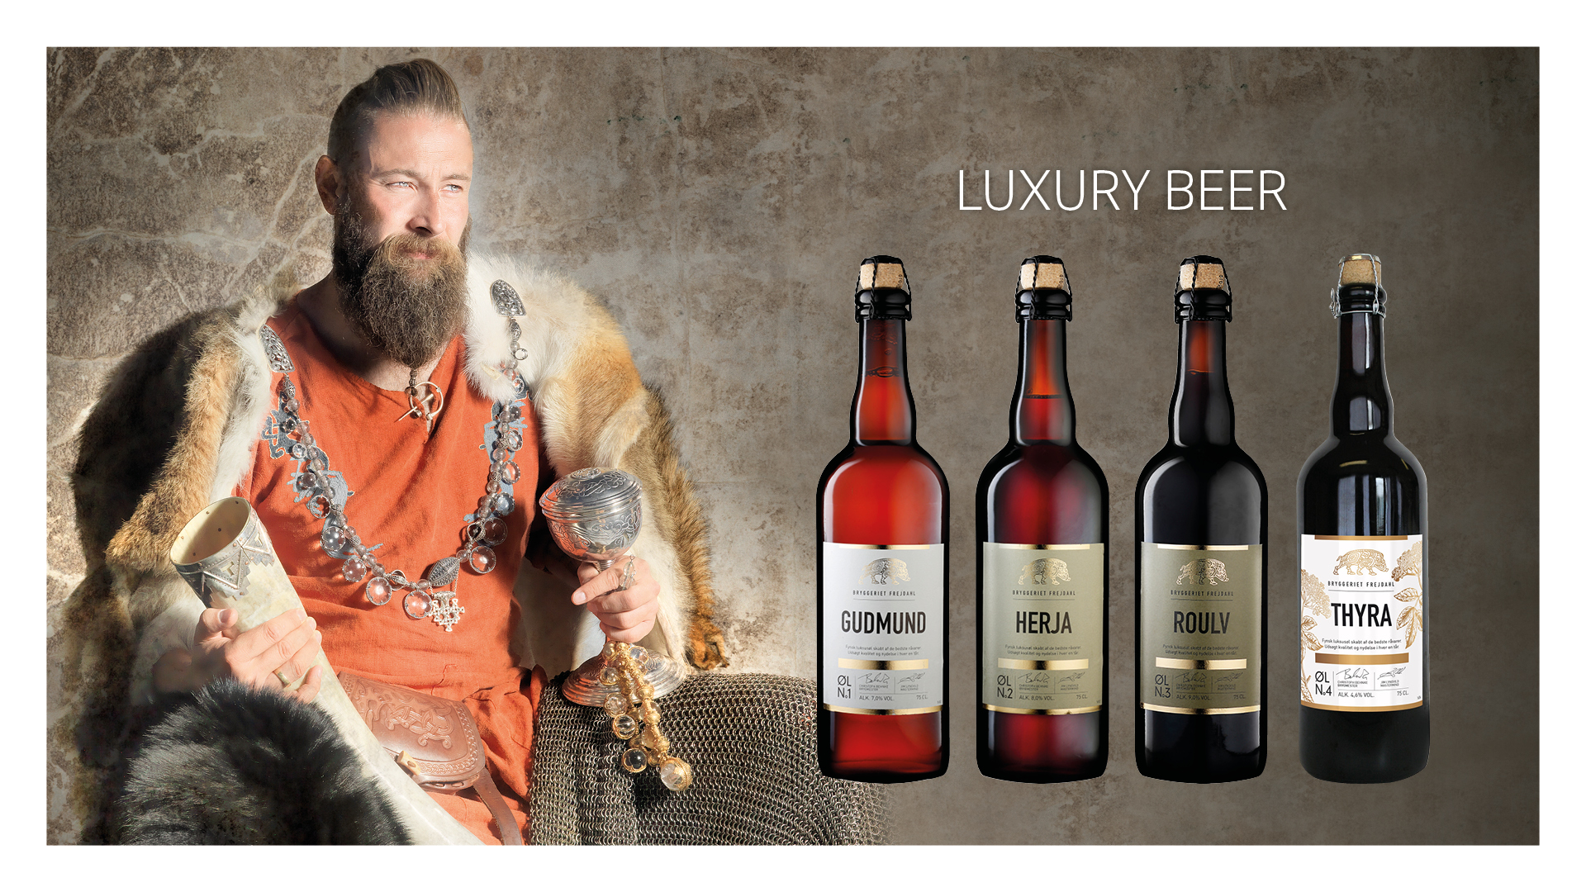

Slide 16
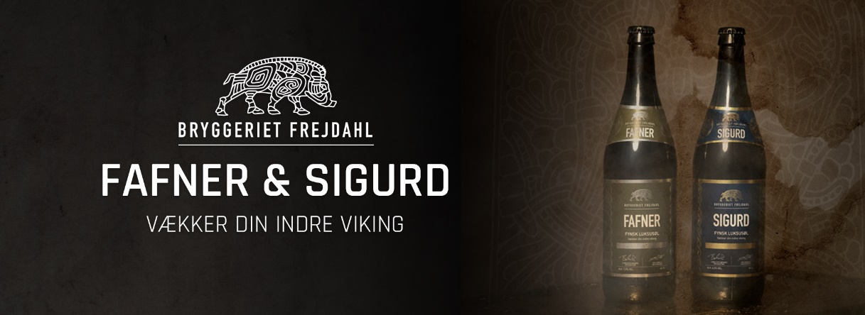
FAFNER, SIGURD AND JOTUN 66 cl.

Slide 17
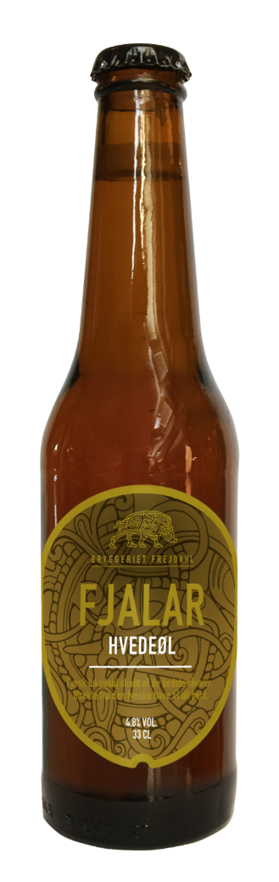
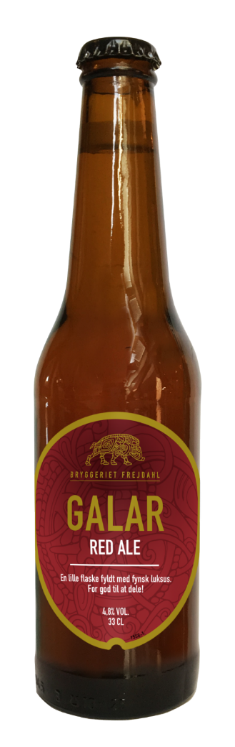
FJALAR AND GALAR 33 CL. 2 DWARFS FROM THE NORDIC MYTHOLOGY

Slide 18
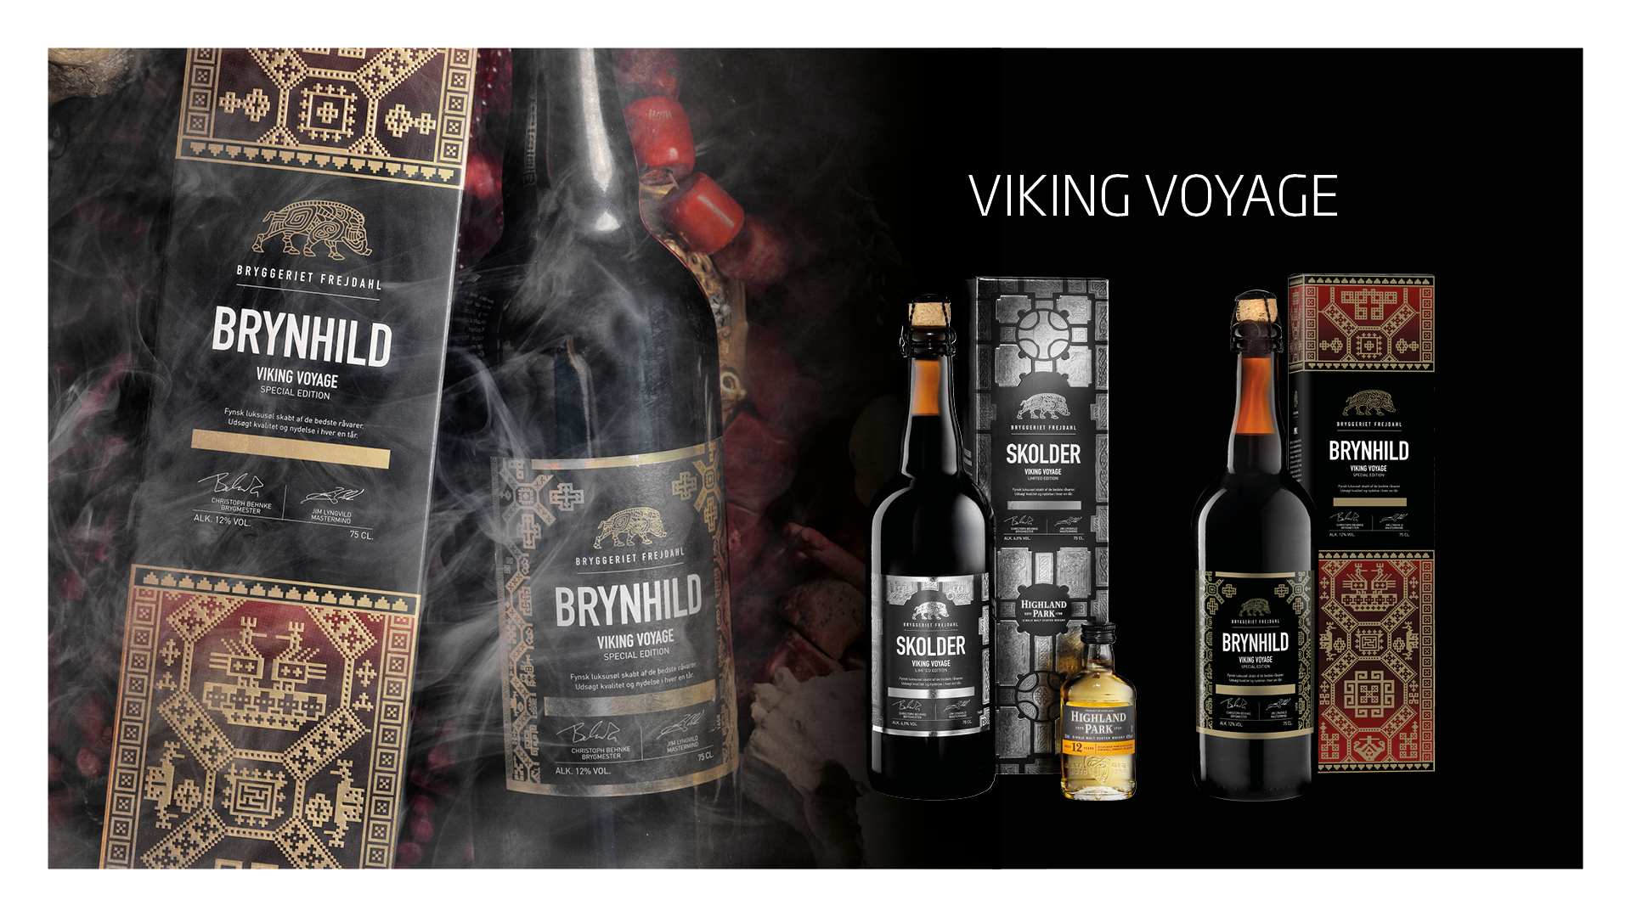

Slide 19
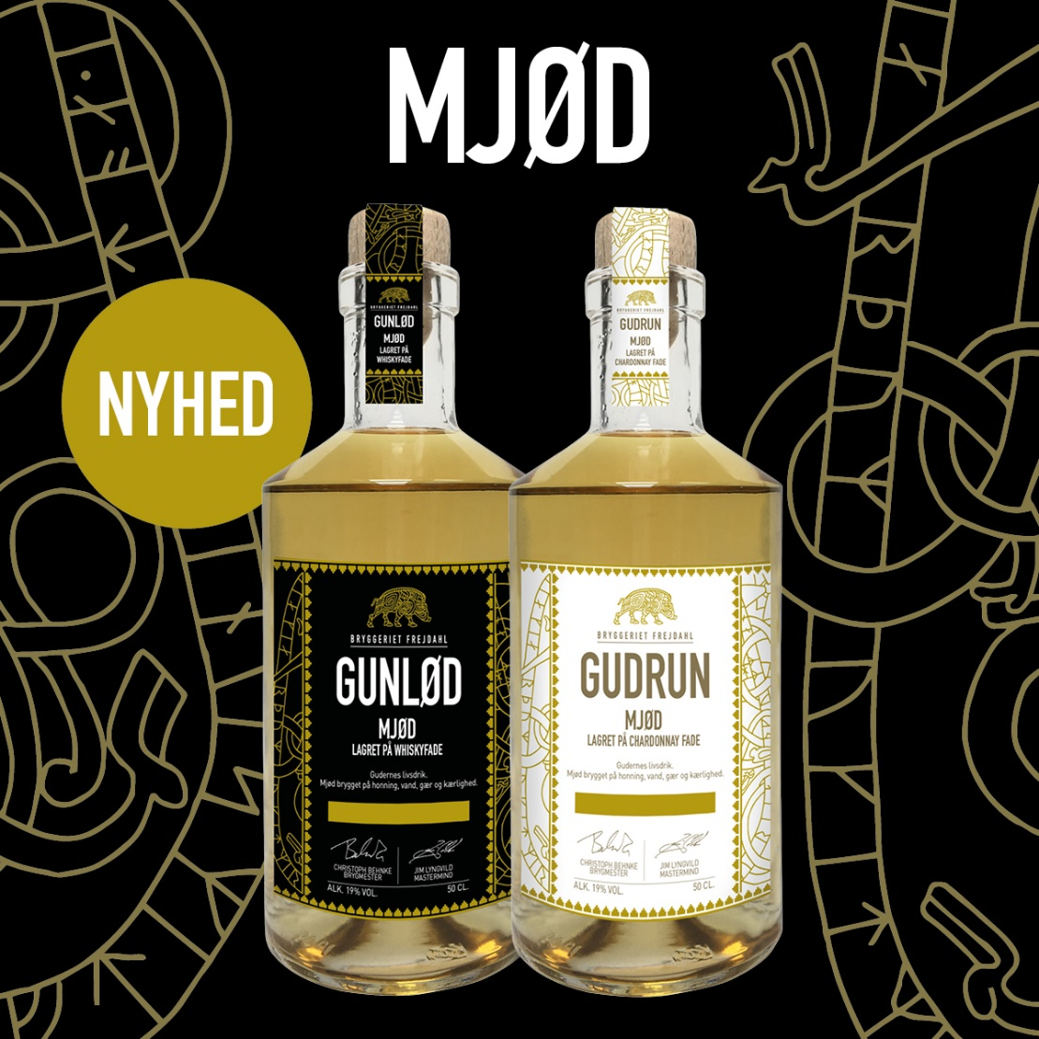
MEAD CHARDONNAY AND HIGHLAND PARK WHISKY

Slide 20
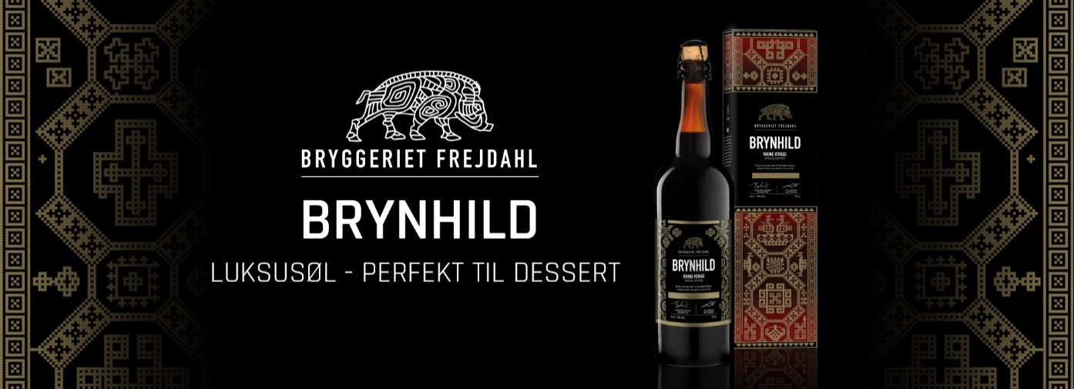
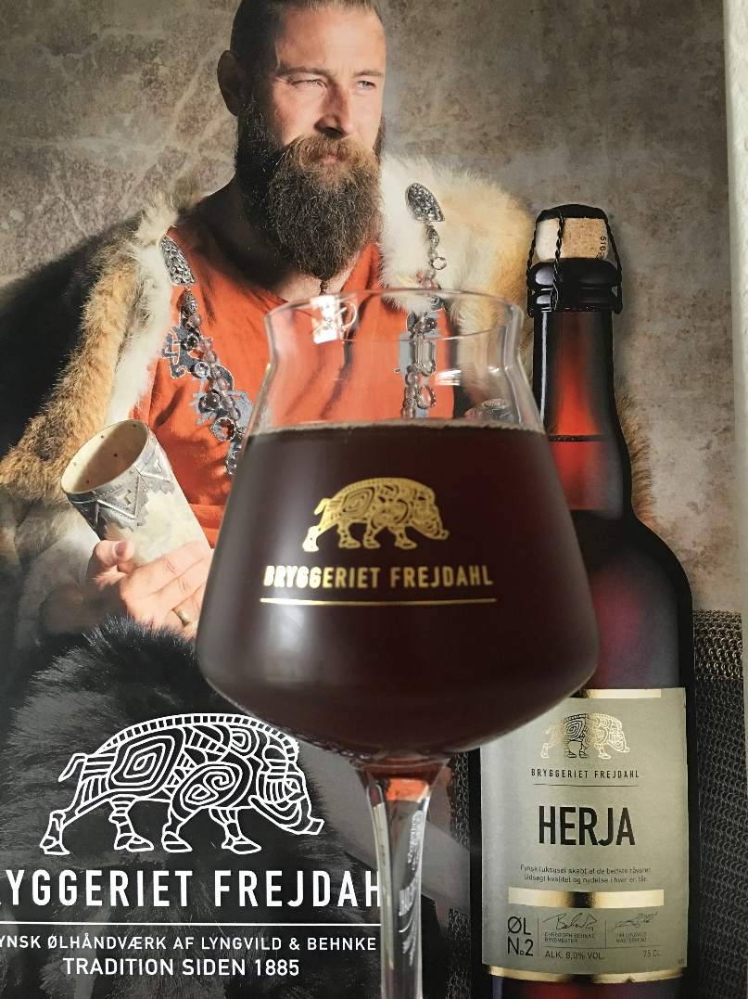
DISTRIBUTION
Dansk Supermarked Special shops Viking events Fairs Shop at the Brewery in Assens Eksport China, Germany, Sweden, Norway, Finland, Island etc. 1.500.000 bottles in 4 year

Slide 21
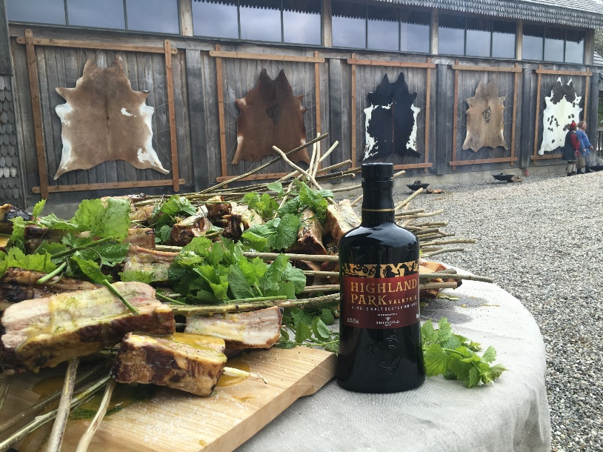
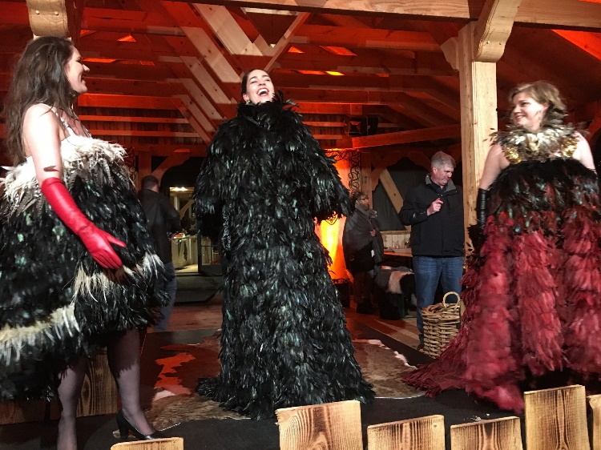
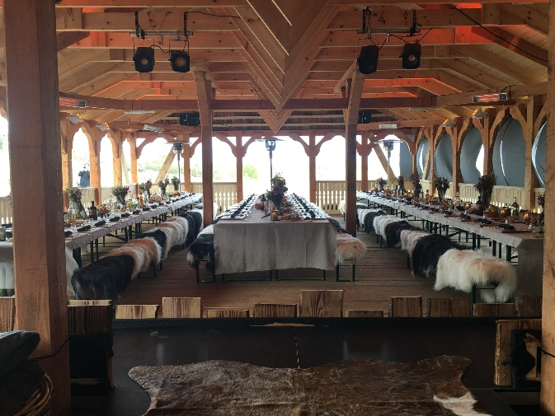
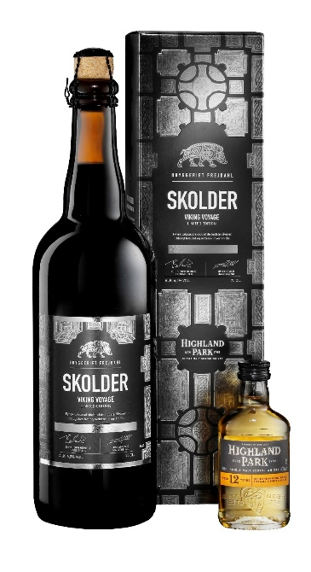
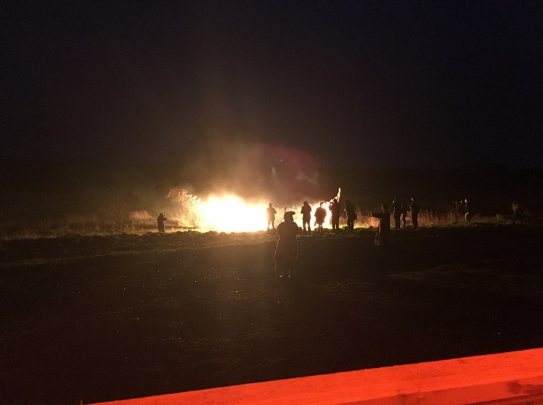
FREJDAHL AND HIGLAND PARK
The whisky with the viking soul Jim Lyngvild knows a lot about vikings Visit at Ravnsborg 1 year of completion of the concept Lounce of the new concept at Roskilde Viking Museum and Ravnsborg Viking Castle 80 journalists from all over the world Viking ship on fire
Redline branding big time

Slide 22
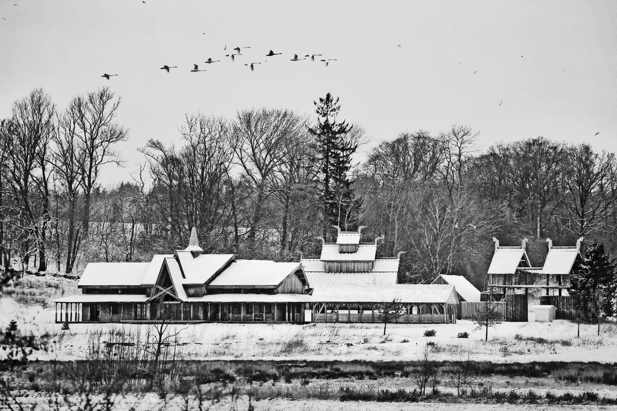
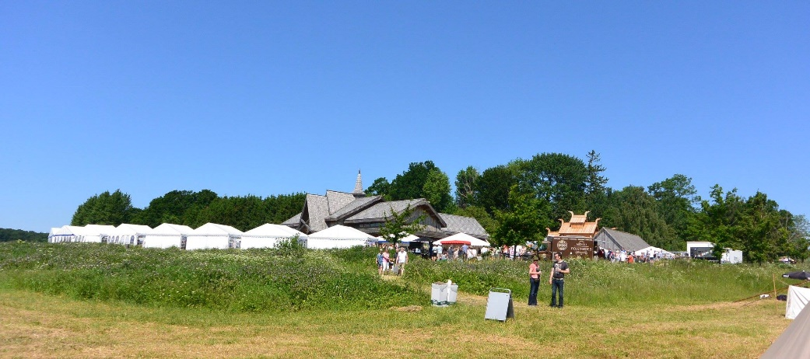
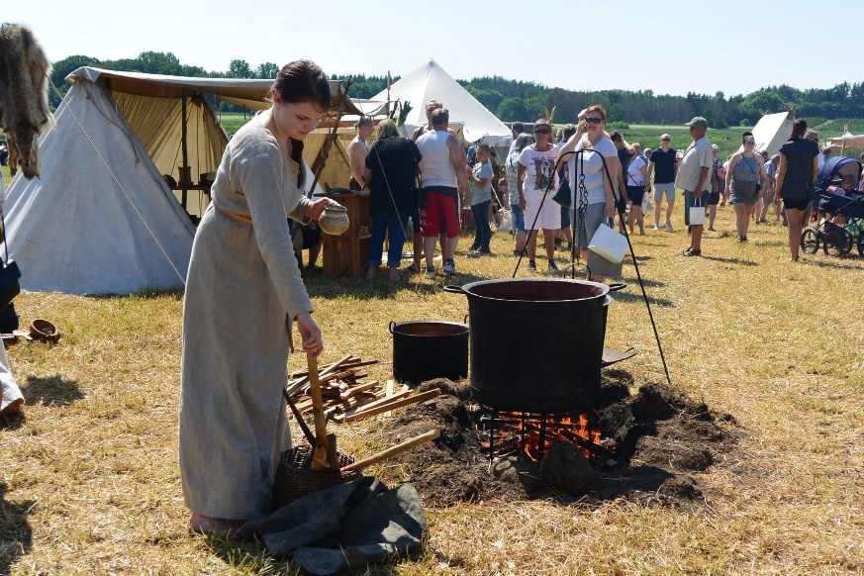
VIKING EVENTS AT RAVNSBORG
Viking event summer and christmas 10-12.000 guest per weekend Viking spirit and real vikings Stands with food, clothes and jewellery We sell 5.000 bottles of beer per weekend Events before the opening a huge succes

Slide 23
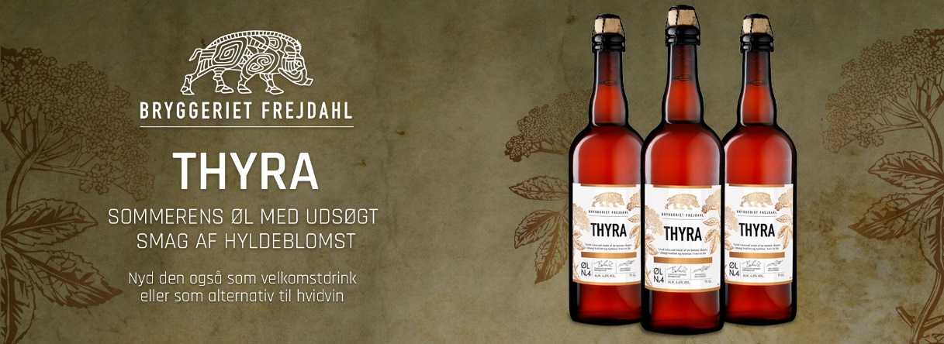

Slide 24
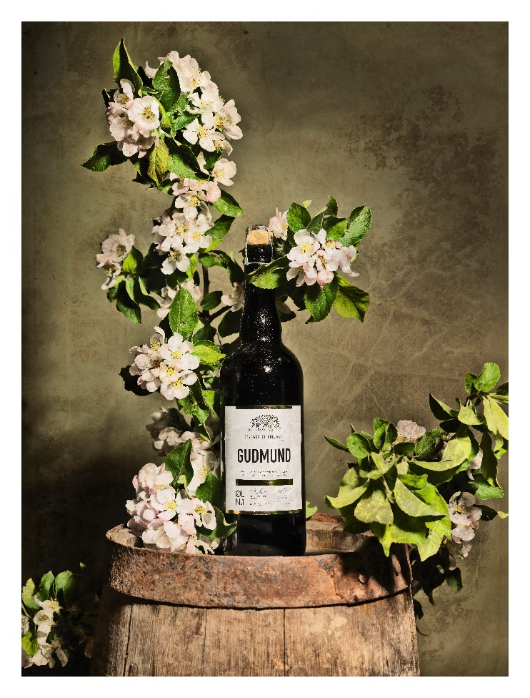
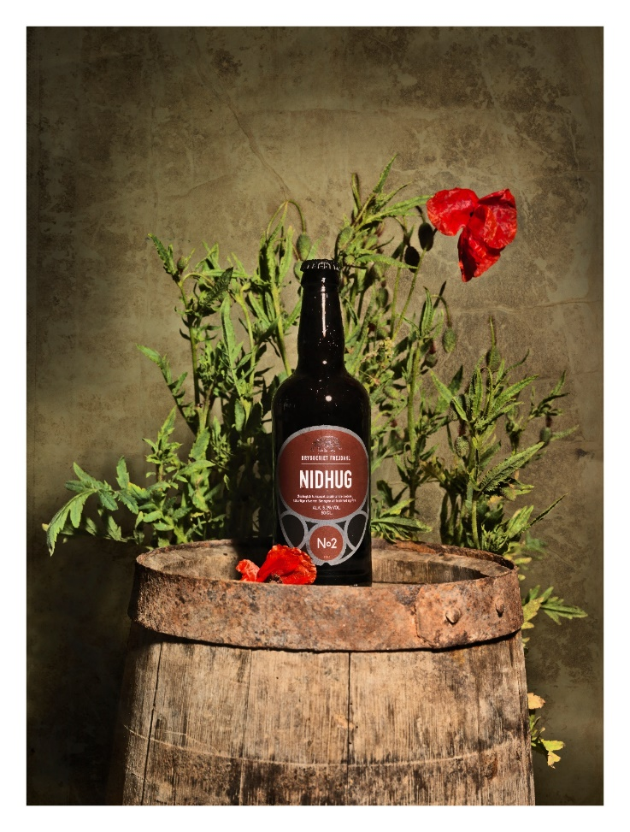
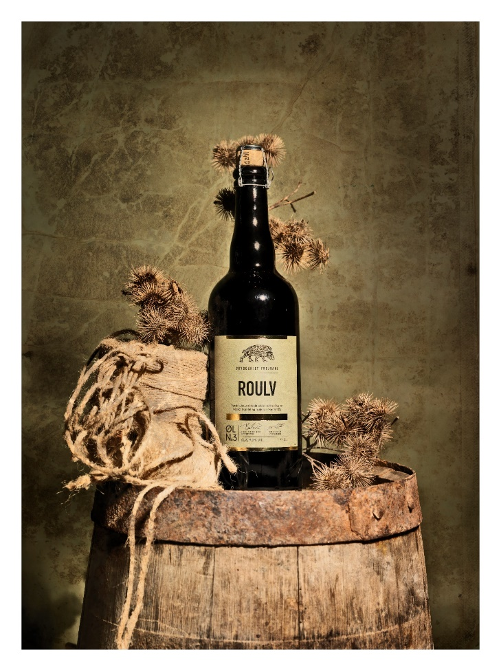
THANK YOU SO MUCH
AND HAVE A NICE WEEK IN DENMARK

